Slide 1
New Technology in Application Development
01. Introduction to Cloud Computing

Slide 2
Content
Cloud computing concepts
Essential Characteristics
Services Models
Deployment Models
Introduction and working with Amazon Web Services

Slide 3
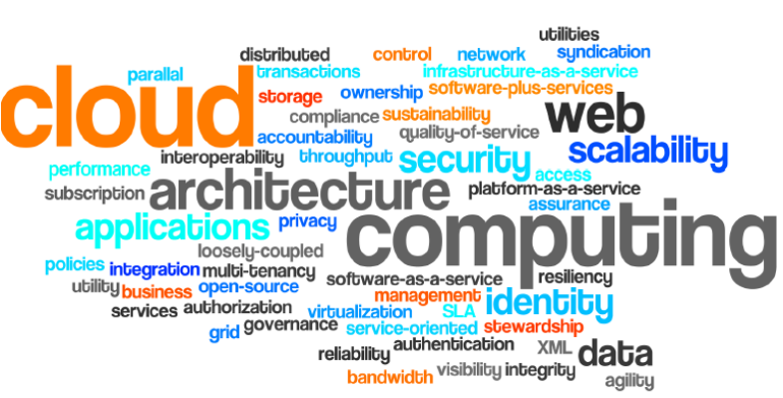
What is Cloud Computing?

Slide 4
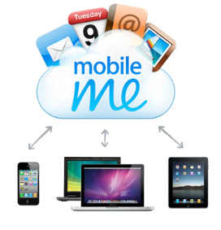
What is Cloud Computing? (cont.)
A Customer-Oriented Definition
Anytime,
Anywhere,
With any device,
Accessing any services
How many of them you still store on your local computer?
Email
Calendars and contacts
Photo/video sharing
Document sharing, or
Anything?

Slide 5
What is Cloud Computing? (cont.)
A Business-Oriented Definition
Key characteristic
Universal access
Scalable services
Infrastructure managing the scaling, not applications
Elasticity: Expenses only incurred when they are needed
New application Service Models
XaaS = X as a Service
Pay-as-you-go

Slide 6
What is Cloud Computing? (cont.)
Another Simple Definition
Electricity:
Available through a well defined interface
Available everywhere and for many devices
Power output, scales on demand
No need to know about how or where it’s generated
Reliable
Low capital expenditure for consumers
Pay for what you use what you use
Making computing resources available as a utility service
Just like the National Electricity Grid

Slide 7

What is Cloud Computing? (cont.)
Generally speaking, cloud computing can be thought of as anything that involves delivering hosted services over the Internet.
According to NIST Cloud computing is a model for enabling ubiquitous, convenient, on-demand network access to a shared pool of configurable computing resources (e.g., networks, servers, storage, applications, and services) that can be rapidly provisioned and released with minimal management effort or service provider interaction.
Notes:
The term Cloud refers to a Network or Internet. In other words, we can say that Cloud is something, which is present at remote location.
Cloud can provide services over network, i.e., on public networks or on private networks, i.e., WAN, LAN or VPN.
Applications such as e-mail, web conferencing, customer relationship management (CRM), all run in cloud.
Cloud Computing refers to manipulating, configuring, and accessing the applications online. It offers online data storage, infrastructure and application. Cloud Computing is both a combination of software and hardware based computing resources delivered as a network service.

Slide 8
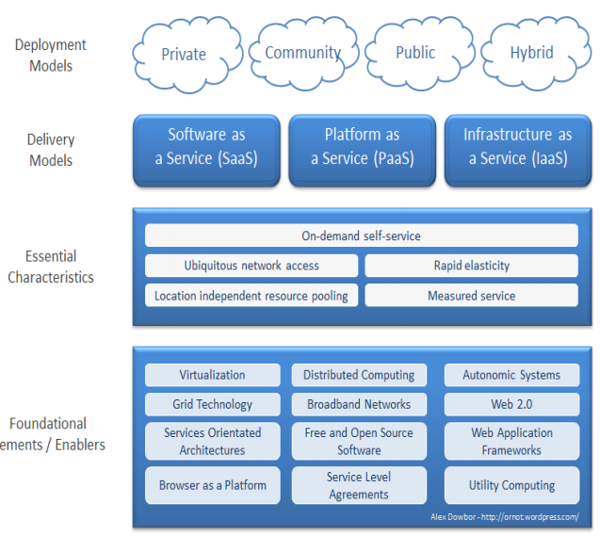
NIST Cloud Computing Model
Five Essential Characteristics
Three Service Models
Four Deployment Models

Slide 9
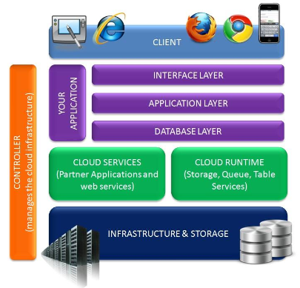
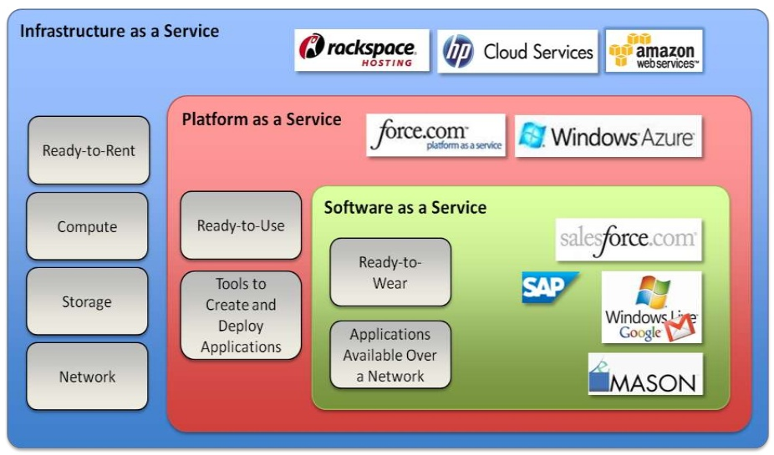
Cloud Computing Architecture

Slide 10
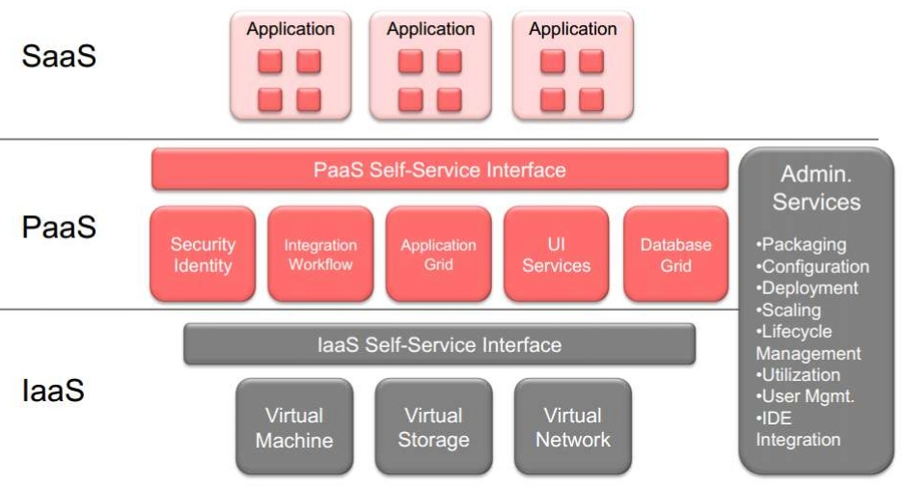
Fundamental Cloud Computing Services

Slide 11





Essential Characteristics
Utility based billing i.e. subscription based
Capability to cope with demand peaks
On-demand Self-service
2
Broad Network Access
Resource Pooling
1
3
Ability of user to sign-up and receive service without delay
Ability to access the service through desktops, mobiles, tabs etc.
Computing resources are pooled to serve multiple consumers using a multi-tenant model
4
Measured Service
5
Rapid Elasticity

Slide 12
Essential Characteristics (contd.)
5 Key Cloud Characteristics
On-demand self-service
A consumer can unilaterally provision computing capabilities, such as server time and network storage, as needed automatically without requiring human interaction with each service provider.
Broad network access (Ubiquitous network access)
Capabilities are available over the network and accessed through standard mechanisms that promote use by heterogeneous thin or thick client platforms (e.g., mobile phones, tablets, laptops, and workstations).
Resource pooling (Location independent resource pooling)
The provider’s computing resources are pooled to serve multiple consumers
Resources can be dynamically assigned and reassigned according to customer demand
Customer generally may not care where the resources are physically located but should be aware of risks if they are located offshore

Slide 13
Essential Characteristics (contd.)
5 Key Cloud Characteristics (cont.)
Rapid elasticity
Capabilities can be expanded or released automatically (i.e., more CPU power, or ability to handle additional users)
To the customer this appears seamless, limitless, and responsive to their changing requirements
Measured service (Pay per use)
Customers are charged for the services they use and the amounts
There is a metering concept where customer resource usage can be monitored, controlled, and reported, providing transparency for both the provider and consumer of the utilized service

Slide 14

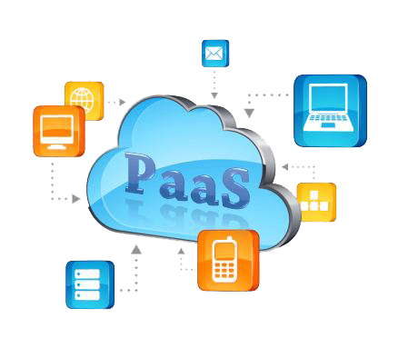
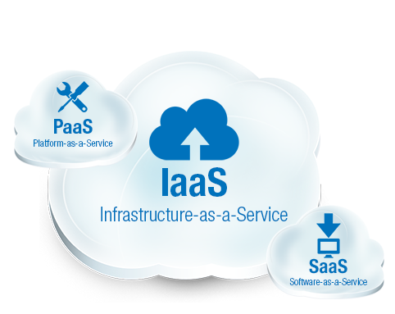
Services Model
1
2
3
Software-as-a-Service
Consume
Platform-as-a-Service
Build
Infrastructure-as-a-Service
Host
End-to-end IT solution hosted on cloud is provided by a service provider to user on subscription basis
Ex:
Force.com, Heroku, Facebook, Google Apps, MS Azure
Application platform hosted on cloud is provided service providers for development of solutions
Cloud infra is provided to client for deploying application platform, building solution & using as data center
Ex:
Amazon EC2
Ex:
Groupon, Google doc, Quickbooks, Salesforce.com

Slide 15
Everything as a Service /XaaS
Everything as a service (EaaS, XaaS,*aaS) is a concept of being able to call up re-usable, fine-grained software components across a network. It is a subset of cloud computing.
The most common and successful example is software as a service (SaaS), but the as a service moniker has been associated with many other functions including communication, infrastructure and platforms, most of which are core components of cloud computing.

Slide 16
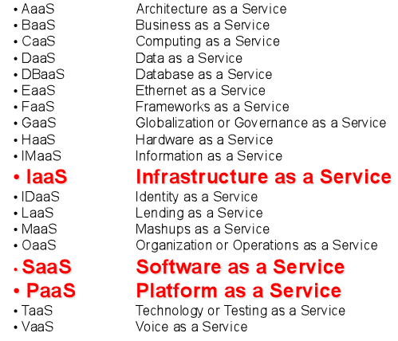

Everything as a Service /XaaS (cont.)

Slide 17

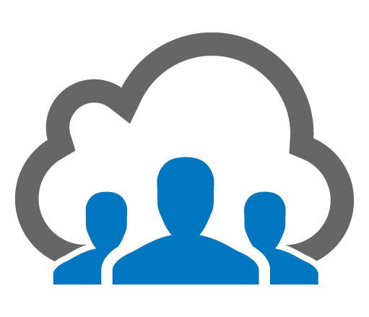


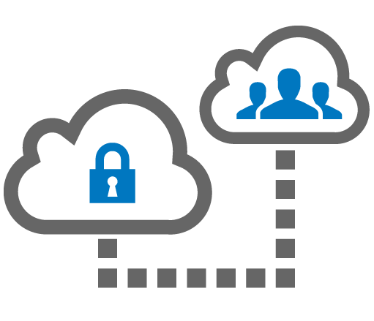
Cloud Types – Deployment Models
1
2
Public Cloud: Resources available to the general public over the internet on a pay-as-you-go basis
Private Cloud: Resource managed and used by an organization
Ex:
MS Azure
Ex:
Amazon EC2
Ex:
Google GovCloud for LA city council
Ex:
IBM Juniper
3
4
Community Cloud: Resource shared by several organizations with common concerns
Hybrid Cloud: Resources partly managed by the service providers and partly by the organization

Slide 18
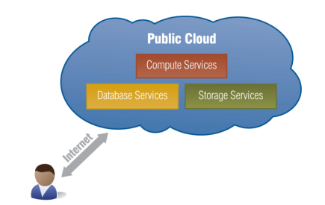
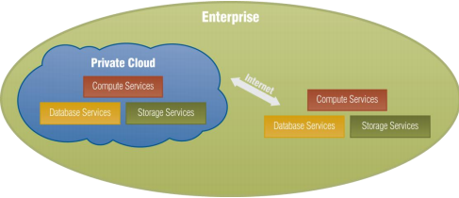
Cloud Types – Deployment Models
Public Cloud: the services are delivered to the client via the Internet from a third party service provider. Example: Amazon
Private Cloud: these services are managed and provided within the organization. There are less restriction on network bandwidth, fewer security exposures and other legal requirements compared to the public Cloud. Example: HP Data Centers

Slide 19



Cloud Computing Infrastructure Models
Public Cloud
Public Cloud
The Cloud Provider
The Cloud Provider
Hybrid Cloud
SME
Connectivity
(Network Access)
SME
Enterprise
Private Cloud
Enterprise
SME
Private Cloud
Notes:
Small and medium sized enterprises (SMEs)

Slide 20

Public Cloud #1: Amazon
Amazon EC2
Elastic Cloud Computing
virtual servers for rent, called Amazon Machine Images (AMIs)
based on Xen
priced on per hour from $0.085 to $1
Amazon S3
Simple Storage Service up to $0.18 per GB storage
from $0.10 per GB transfer
via
REST
SOAP
BitTorrent

Slide 21

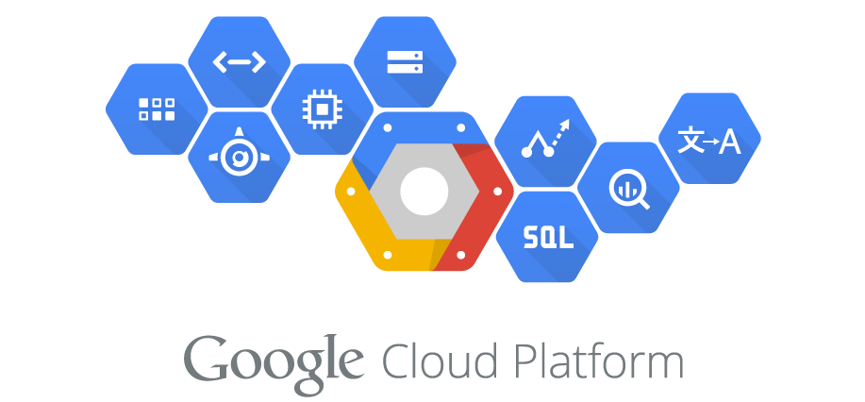
Public Cloud #2: Google
A web application development framework and hosting solution rolled into one
That uses the infrastructure available at Google
so their servers + storage: BigTable
Charges
500MB of storage
up to 5 million page views a month
10 applications per developer account
pay for an extension
Python/JAVA and GAE SDK

Slide 22
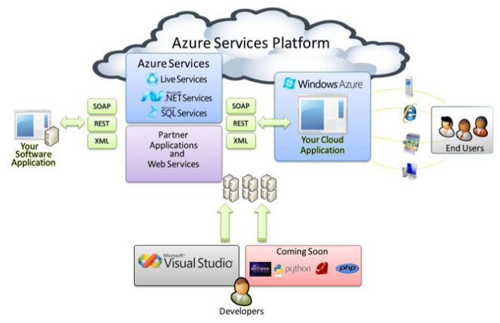
Public cloud #3: Microsoft Azure Services
Released in Feb, 2010
A cloud service operating system that supports the service development/ hosting/management environment
.Net Services
SQL Services
Live Services

Slide 23
Introduction and Working with Amazon Web Services

Slide 24
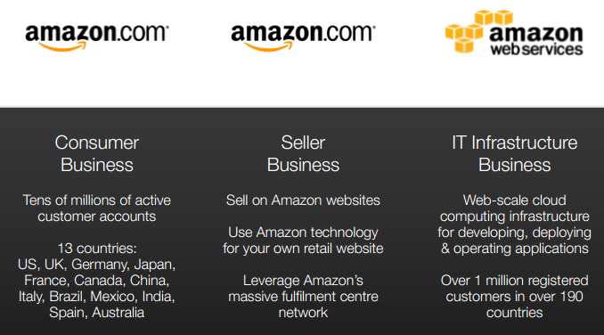
AWS Mission
Enable businesses and developers to use web services (what people now call “the cloud”) to build scalable, sophisticated applications.

Slide 25
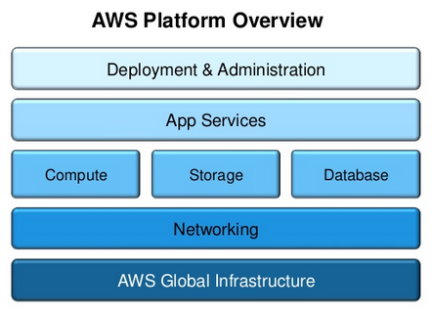
Amazon Web Services Platform Overview

Slide 26
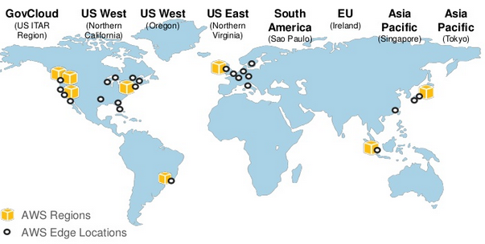
AWS Global Infrastructure

Slide 27
An overview of AWS
AWS is Amazon’s umbrella description of all of their web-based technology services.
Mainly infrastructure services:
Amazon Elastic Compute Cloud (EC2)
Amazon Simple Storage Service (S3)
Amazon Simple Queue Service (SQS)
Amazon CloudFront
Amazon SimpleDB
Amazon EC2 is hiring
http://aws.amazon.com/ec2-jobs/

Slide 28
Amazon Web Services Cloud Platform
AWS is a comprehensive cloud services platform that offers compute power, storage, content delivery, and other functionality that organizations can use to deploy applications and services cost-effectively—with flexibility, scalability, and reliability.
AWS self-service means that you can proactively address your internal plans and react to external demands when you choose.

Slide 29
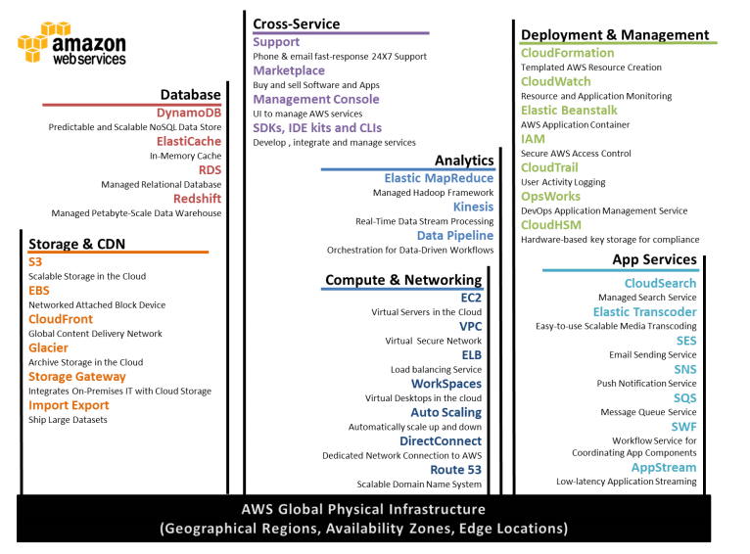
Amazon Web Services Cloud Platform

Slide 30
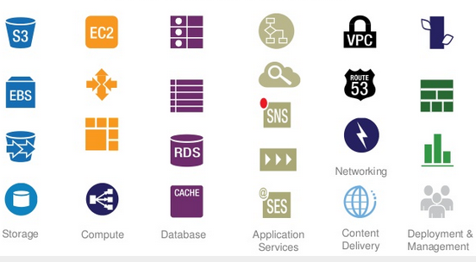
Overview of Services

Slide 31
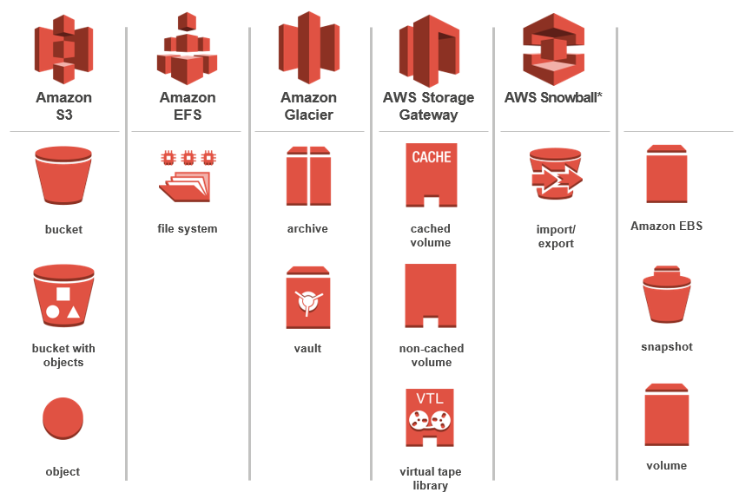
AWS Storage Services

Slide 32
AWS Storage Services (contd.)
Amazon Simple Storage Service (Amazon S3)
Storage for the Internet. Natively online, HTTP access
Store and retrieve any amount of data, any time, from anywhere on the Web
Highly scalable, reliable, fast and durable (default = 99.9999999% durability)
Amazon Elastic Block Store (EBS)
Block storage volumes for use with Amazon EC2 instances.
Attach to running instance and expose as a block device
Off-instance storage that persists independently of Amazon EC2 instances
Snapshots stored durably in Amazon S3

Slide 33
AWS Storage Services (cont.)
AWS Storage Gateway
Easily backup on-premises data to AWS
Store snapshots in Amazon S3 for backup and disaster recovery
Simple software appliance - no changes required to your on- premises architecture

Slide 34
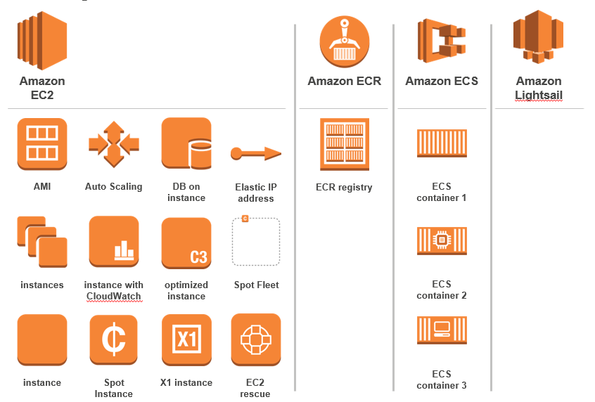
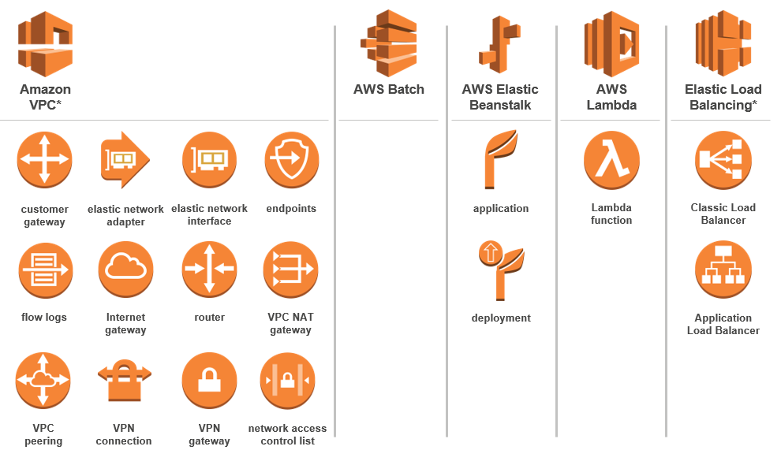
AWS Compute Services

Slide 35
AWS Compute Services (contd.)
Amazon Elastic Compute Cloud (Amazon EC2)
Resizable compute capacity
Complete control of your computing resources
Reduces the time required to obtain and boot new server instances to minutes
Scale capacity as your computing requirements change
Pay only for capacity that you actually use
Amazon Elastic MapReduce (Amazon EMR)
Easily and cost-effectively process vast amounts of data
Utilizes a hosted Hadoop framework

Slide 36
AWS Compute Services (contd.)
Auto Scaling
Scale your Amazon EC2 capacity automatically
Well suited for applications that experience variability in usage
Available at no additional charge
Elastic Load Balancing
Supports the routing and load balancing of HTTP, HTTPS and TCP traffic to EC2 instances
Supports health checks to ensure detect and remove failing instances
Dynamically grows and shrinks required resources based on traffic
Seamlessly integrates with Auto-scaling to add and remove instances based on scaling activities
Single CNAME provides stable entry point for DNS configuration

Slide 37
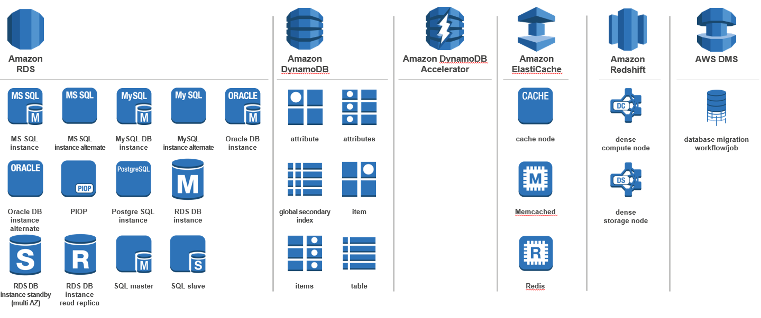
AWS Database Services

Slide 38
AWS Database Services (contd.)
Amazon DynamoDB
Fully-managed NoSQL database service
Store any amount of data – no limits
Easily provision and change the request capacity needed for each table
Fast, predictable performance
Amazon SimpleDB
Core database functions of data indexing and querying
No schema, automatic indexing
Eliminates the administrative burden of data modeling, index maintenance, and performance tuning
Real-time lookup and simple querying of structured data

Slide 39
AWS Database Services (contd.)
Amazon Relational Database Service (RDS)
Cost-efficient and resizable capacity
Manages time-consuming database administration tasks
Access to the full capabilities of a familiar MySQL, Oracle, or SQL Server database
Code, applications, and tools you already use today work seamlessly
Automatically patches the database software and backs up your database

Slide 40
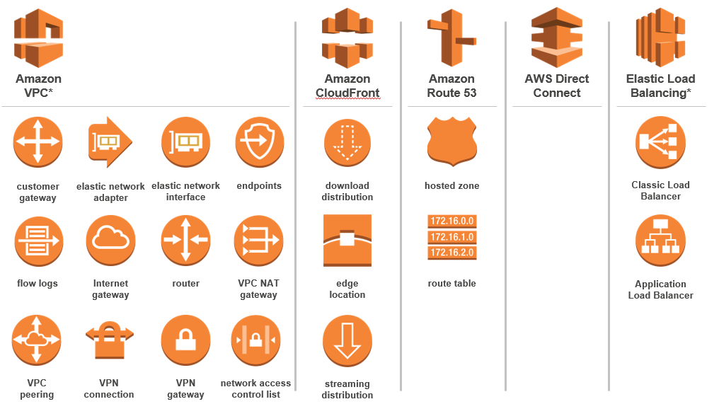
AWS Networking and Content Delivery

Slide 41
AWS Networking Services
Amazon Virtual Private Cloud (Amazon VPC)
Provision a private, isolated section of the Amazon Web Services (AWS) Cloud where you can launch AWS resources in a virtual network that you define
Define a virtual network topology that closely resembles a traditional network that you might operate in your own datacenter
You have complete control over your virtual networking environment: selection of IP address range, creation of subnets, configuration of route tables, and network gateways
Amazon Route 53
Route end users to Internet applications
Answers DNS queries with low latency by using a global network of DNS servers

Slide 42
AWS Content Delivery
Amazon CloudFront
Web service for content delivery
Distribute content to end users with low latency, high data transfer speeds, and no commitments
Delivers your content using a global network of edge locations
Supports download, streaming and live streaming with Adobe FMS

Slide 43
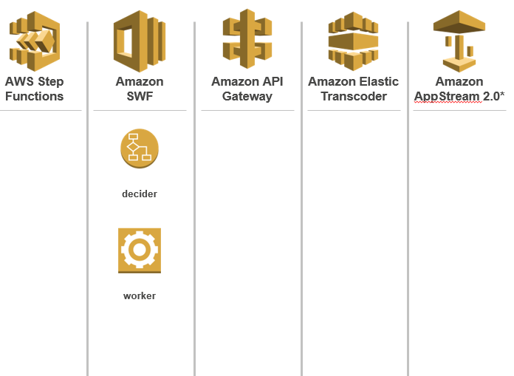
AWS Application Services
Amazon Simple Workflow Service (Amazon SWF)
Run application workflows and business processes on AWS
Manage processes across Cloud, mobile and on-premises environments
Use any programming language for workflow logic

Slide 44
AWS Application Services (contd.)
Amazon Simple Notification Service (Amazon SNS)
Set up, operate, and send notifications
Publish messages from an application and immediately deliver them to subscribers or other applications
Amazon Simple Queue Service (Amazon SQS)
Hosted queue for storing messages as they travel between computers
Move data between distributed components of their applications

Slide 45
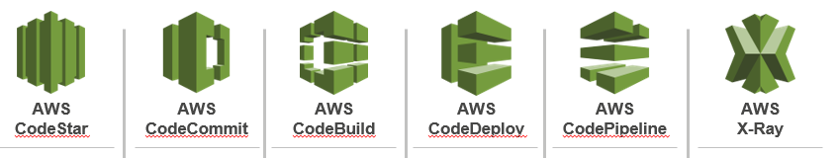
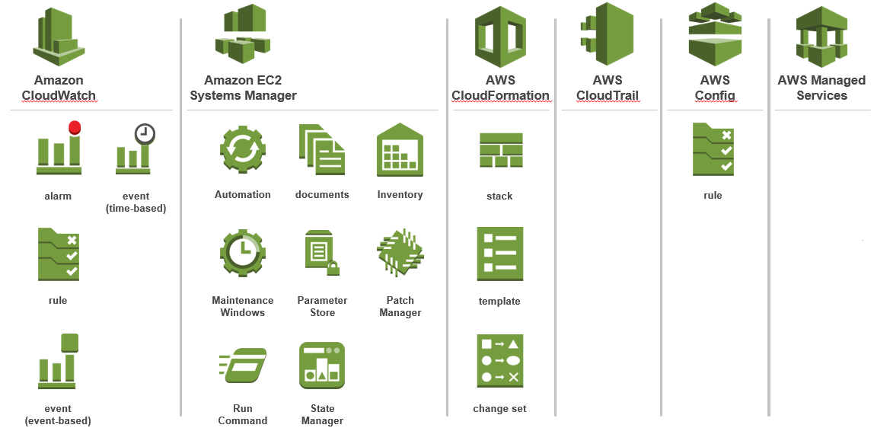
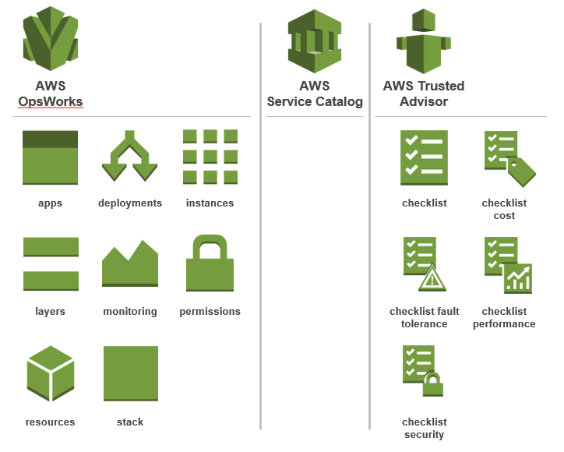
AWS Deployment and Management Services

Slide 46
AWS Deployment and Management Services
AWS Elastic Beanstalk (beta)
Automatically handles the deployment details of capacity provisioning, load balancing, auto-scaling, and application health monitoring
Retain full control over the AWS resources powering your application
Run and manage existing PHP applications with no changes to application code
Provides full control over the infrastructure and the software
AWS CloudFormation
Create templates of stack of resources
Deploy stack from template with runtime parameters
CloudFormer supports generating templates from running environments

Slide 47
AWS Deployment and Management Services
Amazon CloudWatch
Visibility into resource utilization, operational performance, and overall demand patterns
Metrics including CPU utilization, disk reads and writes, and network traffic
Custom application-specific metrics of your own
Accessible via AWS Management Console, APIs, SDK, or CLI
AWS Identity and Access Management (IAM)
Create Users and Groups with specific, restricted access to specific AWS resources and API calls
User-specific credentials for accessing management console and making API calls
Provision identity federation between corporate directory and AWS services

Slide 48
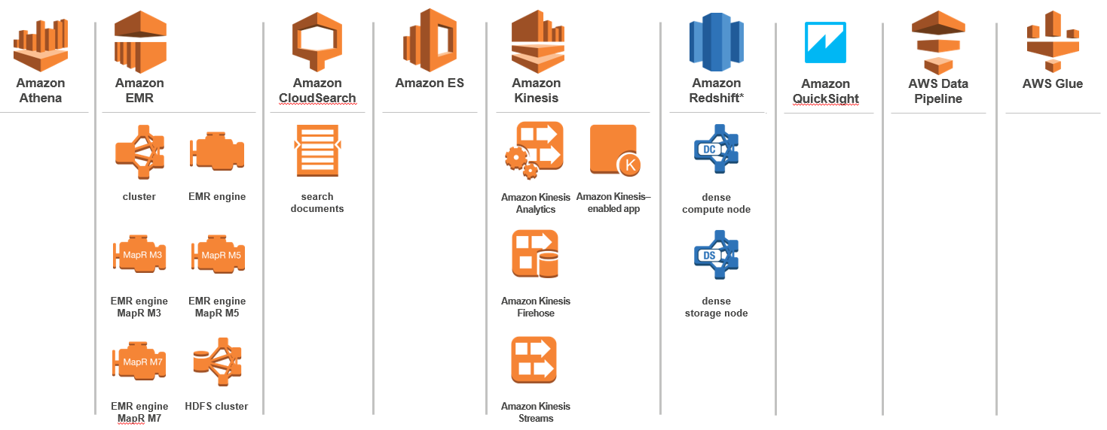
AWS Analytics Services

Slide 49
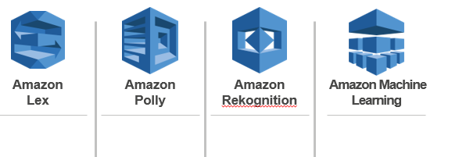
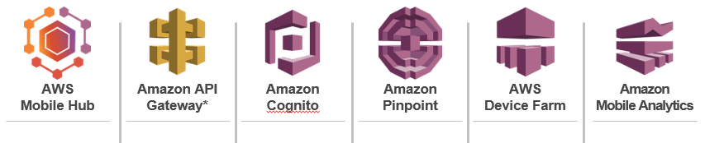
Other services
Artificial Intelligence
Mobile Services

Slide 50
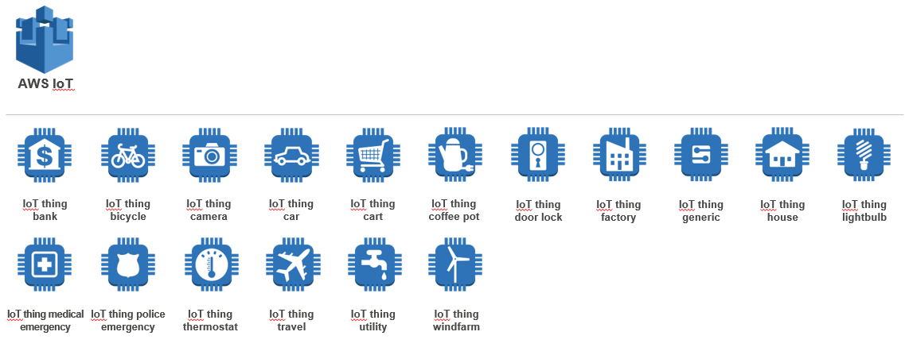
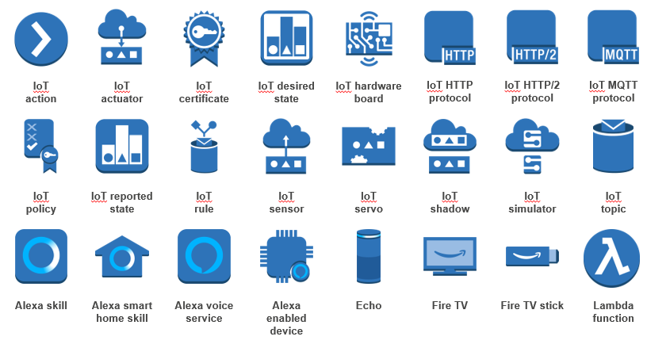
Other services (contd.)
Internet of Things (IoT)

Slide 51
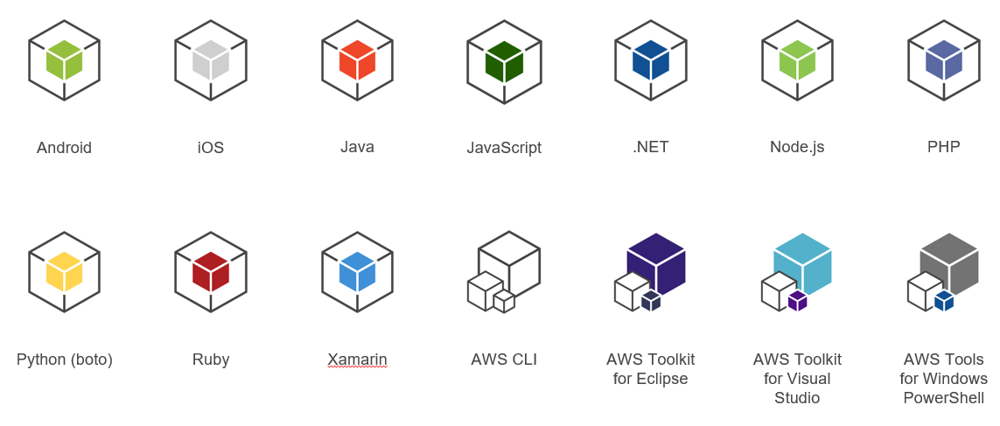
AWS SDKs

Slide 52
Sample Architecture
Sample Architecture: Migration your Web applications
Web Application Design
A typical web application could need:
Compute power
Storage capacity for images, music, etc.
Content distribution
Database storage
Messaging between components
Payment options to enable e-commerce
Load balancing for optimal performance

Slide 53
Web Application Design on AWS
A typical web application could need:
Compute power (Amazon EC2)
Storage capacity for images, music, etc. (Amazon S3)
Content distribution (Amazon CloudFront)
Database storage (Amazon EBS, DynamoDB, RDS)
Messaging between components (Amazon SQS)
Payment options to enable e-commerce (Amazon FPS)
Load balancing for optimal performance (Amazon EC2)

Slide 54
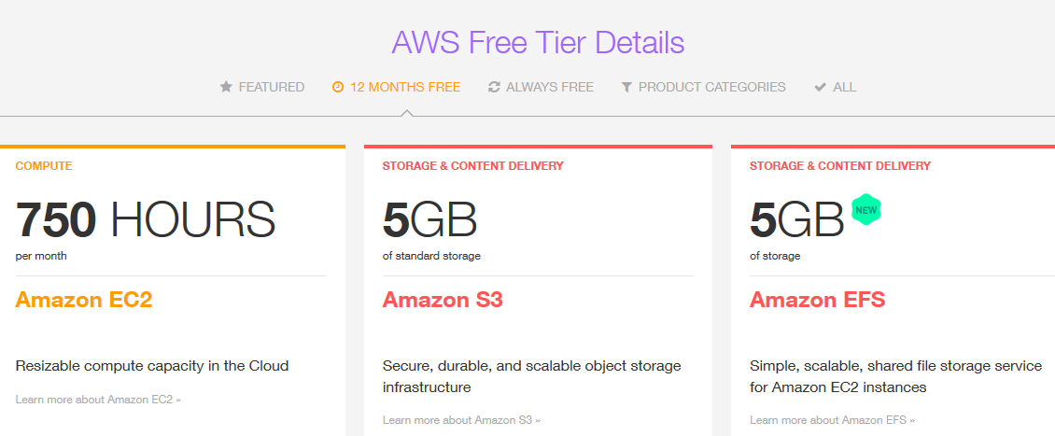
AWS Free Tier

Slide 55
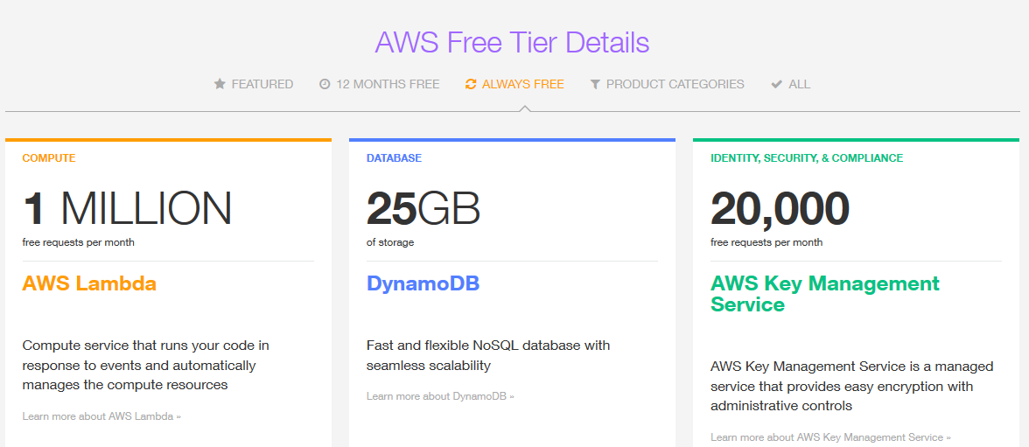
AWS Free Tier

Slide 56
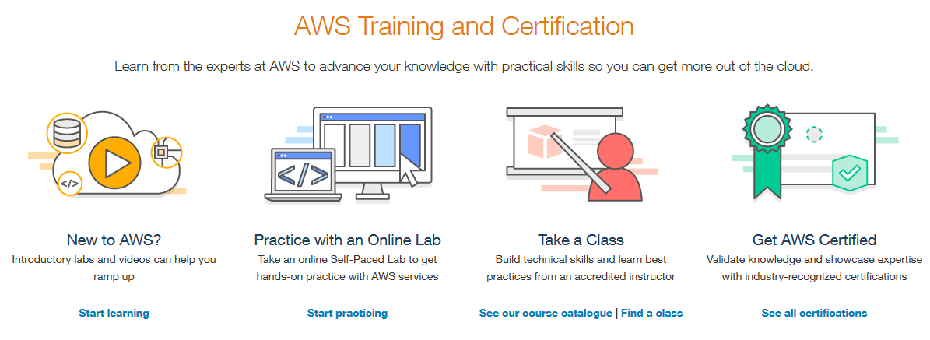
AWS Training and Certification

Slide 57


